Slide 1

Web Testing – Altex Proiect IT SCHOOL – Automation with Java and Selenium

Slide 2

AGENDA
Frameworks
Test cases
Visual studio code run

Slide 3

This code was developed using Java and the Selenium framework to facilitate robust and efficient automated testing. By leveraging Selenium's powerful web automation capabilities and Java's flexibility, it ensures reliable test execution, improved test coverage, and enhanced software quality.
Frameworks

Slide 4

Test cases
Comprehensive and Structured Test Scenarios for Effective Software Validation

Slide 5
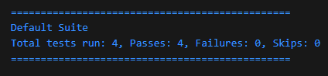
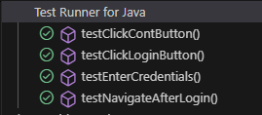
Test Case ID: TC_ALTX_001
Objective: Verify that a user can log in and navigate to the "Telefoane" page.
Preconditions:
A valid user account exists.
The browser is open on Altex.ro.
Test Steps:
Click the "Cont" button to open the login form.
Enter "testmail123@gmail.com" in the email field.
Enter "TestMail123." in the password field.
Click the "Autentificare" button and wait for login.
Navigate to "https://altex.ro/telefoane" and verify the page loads.
Expected Result:
User logs in successfully.
The "Telefoane" page loads correctly.
Postconditions:
The user remains logged in.

Slide 6
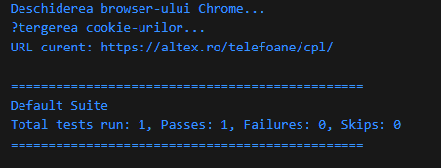
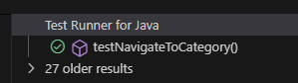
Test Case ID: TC_ALTX_002
Objective: Verify that a user can successfully navigate to the "Telefoane" category.
Preconditions:
The user is logged in.
The browser is open on Altex.ro.
Test Steps:
Ensure any overlay is dismissed.
Click on the "Produse" button.
Select "Telefoane, Tablete" from the menu.
Click on the "Telefoane" subcategory.
Verify the page URL contains /telefoane.
Expected Result:
The user is redirected to the "Telefoane" category page.
Postconditions:
The page displays the correct category.

Slide 7
Test Case ID: TC_ALTX_003
Objective: Verify that a user can successfully add the first product from the "Telefoane" category to the cart.
Preconditions:
The user is logged in.
The user has navigated to the "Telefoane" category.
Test Steps:
Select and click on the first visible product.
Wait for the product page to load.
Expected Result:
The first product was selected
Postconditions:
The user navigated successfully to the first product page

Slide 8
Test Case ID: TC_ALTX_004
Objective: Verify that a user can successfully add the first product from the "Telefoane" category to the cart.
Preconditions:
The user is logged in.
The user has navigated to the "Telefoane" category.
Test Steps:
Select and click on the first visible product.
Wait for the product page to load.
Click the "Adaugă în coș" button.
Verify that the cart confirmation popup appears.
Expected Result:
The selected product is added to the cart, and a confirmation popup is displayed.
Postconditions:
The product remains in the cart for checkout.

Slide 9
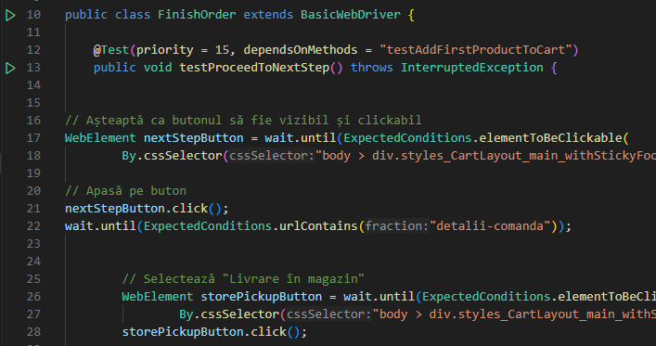
Test Case ID: TC_ALTX_005
Objective: Verify that a user can proceed to the next step in the checkout process and select store pickup
Preconditions:
The user has added a product to the cart
The user is on the cart page
Test Steps:
Click on the “Pasul Urmator” button
Wait for the “Detalii comanda” page to load
Select the “Livrare in magazin” option
Choose the region as “Bucuresti”
Select a specific store
Expected results:
The user is redirected to the “Detalii comanda” page
“Livrare in magazin” is selected
The selected store is confirmed
Postconditions:
The selected store remains assigned for order pickup

Slide 10
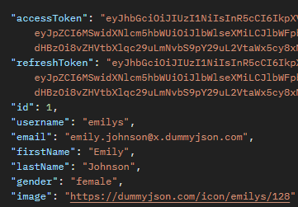
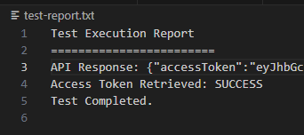
Additional API Test (not altex related)
Objective: Verify that a user can successfully log in using the API and receive an access token.
Preconditions: • The API endpoint https://dummyjson.com/auth/login is available. • The user has valid credentials (username: emilys, password: emilyspass).
Test Steps:
Send a POST request to /auth/login with valid login credentials.
Ensure the request includes Content-Type: application/json and Accept: application/json headers.
Extract the response body.
Verify that the response contains an accessToken.
Expected Result: • The response status code is 200 OK. • The response body contains a valid accessToken.
Postconditions: • The user remains authenticated with the provided token for further API interactions.

Slide 11
Test Results
Test cases | Description | Pass | Fail
TC_ALTX_001 | Verify that a user can log in and navigate to the "Telefoane" page |  | -
TC_ALTX_002 | Verify that a user can successfully navigate to the "Telefoane" category. |  | -
TC_ALTX_003 | Verify that a user can successfully add the first product from the "Telefoane" category to the cart. |  | -
TC_ALTX_004 | Verify that a user can successfully add the first product from the "Telefoane" category to the cart. |  | -
TC_ALTX_005 | Verify that a user can proceed to the next step in the checkout process and select store pickup |  | -
API_TEST_001 | Verify that a user can successfully log in using the API and receive an access token. |  | -

Slide 12

THANK YOU!
Androne Oana Alexandra
alexandra_androne@yahoo.com

